Slide 1

Stacks
Dr. Aiman Hanna
Department of Computer Science & Software Engineering
Concordia University, Montreal, Canada
These slides has been extracted, modified and updated from original slides of :
Data Structures and Algorithms in Java, 5th edition. John Wiley& Sons, 2010. ISBN 978-0-470-38326-1.
Data Structures and the Java Collections Framework by William J. Collins, 3rdedition, ISBN 978-0-470-48267-4. Both books are published by Wiley.
Copyright © 2010-2011 Wiley
Copyright © 2010 Michael T. Goodrich, Roberto Tamassia
Copyright © 2011 William J. Collins
Copyright © 2011-2012 Aiman Hanna
All rights reserved
Stacks
Stacks & Queues

Slide 2
Abstract Data Types (ADTs)
An abstract data type (ADT) is an abstraction/model of a data structure.
An abstract data type is defined indirectly, only by the operations that may be performed on it. An ADT specifies:
    Data stored
    Operations on the data
    Error conditions associated with operations
Stacks

Slide 3
Abstract Data Types (ADTs)
Example: ADT modeling a simple stock trading system
  The data stored are buy/sell orders
  The operations supported are
    order buy(stock, shares, price)
    order sell(stock, shares, price)
    void cancel(order)
  Error conditions:
    Buy/sell a nonexistent stock
    Cancel a nonexistent order
Stacks

Slide 4

The Stack ADT
The Stack ADT stores arbitrary objects.
Insertions and deletions follow the last-in first-out (LIFO) scheme. Think of a spring-loaded plate dispenser.
Formally, a stack is an ADT that support the following main operations:
  push(object): inserts an element
  object pop(): removes and returns the last inserted element
Examples: operations of “Back” button on a browser or “undo” on text editors.
Stacks

Slide 5
The Stack ADT
Secondary stack operations include:
  object top(): returns the last inserted element without removing it
  integer size(): returns the number of elements stored
  boolean isEmpty(): indicates whether no elements are stored
Stacks

Slide 6
The Stack ADT
The following table shows a series of stack operations and their effects on an initially empty stack of integers:
Operation | Output | Stack Contents
push(5) | -- | [5]
push(2) | -- | [5, 2]
push(8) | -- | [5, 2, 8]
pop() | 8 | [5, 2]
isEmpty() | false | [5, 2]
top() | 2 | [5, 2]
pop() | 2 | [5]
pop() | 5 | []
pop() | ”error” | []
Stacks

Slide 7
The Java Built-in Stack Class
Because of its importance, Java has a built-in class for the stack (java.util.Stack).
The class has various methods, including:
  push(), pop(), peek(), empty(), and size().
pop() and peek() throw EmptyStackException if operations are attempted on an empty stack. .
While this class is convenient, it is very important to know how to design and implement a Stack class from scratch.
Stacks

Slide 8
Stack Interface in Java
public interface Stack<T> {
public int size();
public boolean isEmpty();
public T top()
throws EmptyStackException;
public void push(T element);
public T pop()
throws EmptyStackException;
}
Java has also an interface corresponding to our Stack ADT.
Requires EmptyStackException.
Different from the built-in Java class java.util.Stack.
Stacks

Slide 9
Exceptions
Attempting the execution of an operation of ADT may sometimes cause an error condition, called an exception.
Exceptions are said to be “thrown” by an operation that cannot be executed.
In the Stack ADT, operations pop and top cannot be performed if the stack is empty.
Attempting the execution of pop or top on an empty stack throws an EmptyStackException.
Stacks

Slide 10
Applications of Stacks
Direct applications
  Page-visited history in a Web browser
  Undo sequence in a text editor
  Chain of method calls in the Java Virtual Machine
Indirect applications
  Auxiliary data structure for algorithms
  Component of other data structures
Stacks

Slide 11
Method Stack in the JVM
The Java Virtual Machine (JVM) keeps track of the chain of active methods with a stack.
When a method is called, the JVM pushes on the stack a frame containing
  Local variables and return value
  Program counter, keeping track of the statement being executed
When a method ends, its frame is popped from the stack and control is passed to the method on top of the stack.
Allows for recursion.
main() {
int i = 5;
foo(i);
}
foo(int j) {
int k;
k = j+1;
bar(k);
}
bar(int m) {
…
}
bar
PC = 1
m = 6
foo
PC = 3
j = 5
k = 6
main
PC = 2
i = 5
Stacks

Slide 12
Array-based Stack
A simple way of implementing the Stack ADT uses an array.
We add elements from left to right.
A variable keeps track of the index of the top element.
Algorithm size()
return t + 1
Algorithm pop()
if isEmpty() then
throw EmptyStackException
else
t ← t − 1
return S[t + 1]
…
S
0
1
2
t
Stacks

Slide 13
Array-based Stack (cont.)
The array storing the stack elements may become full.
A push operation will then throw a FullStackException
  Limitation of the array-based implementation
  We need to define this class; it is not intrinsic to the Stack ADT
Algorithm push(o)
if t = S.length − 1 then
throw FullStackException
else
t ← t + 1
S[t] ← o
…
S
0
1
2
t
Stacks

Slide 14
Performance and Limitations
Performance
  Let n be the number of elements in the stack
  The space used is O(n)
  Each operation runs in time O(1)
Limitations
  The maximum size of the stack must be defined a priori and cannot be changed
  Trying to push a new element into a full stack causes an implementation-specific exception
Stacks

Slide 15
Array-based Stack in Java
public class ArrayStack<E>
implements Stack<E> {
// holds the stack elements
private E S[ ];
// index to top element
private int top = -1;
// constructor
public ArrayStack(int capacity) {
S = (E[]) new Object[capacity]);
}
public E pop()
throws EmptyStackException {
if isEmpty()
throw new EmptyStackException
(“Empty stack: cannot pop”);
E temp = S[top];
// facilitate garbage collection:
S[top] = null;
top = top – 1;
return temp;
}
… (other methods of Stack interface)
Stacks

Slide 16
Example use in Java
/** A non-recursive generic method for reversing an array */
public static <E> void reverse(E[] a){
Stack<E> s = new ArrayStack<E>(a.length);
for(int i = 0; i < a.length; i++)
s.push(a[i]);
for(int i = 0; i < a.length; i++)
a[i] = s.pop();
}
Stacks

Slide 17
Example use in Java
public class Tester {
// … other methods
public intReverse(Integer a[]) {
Stack<Integer> s; s = new ArrayStack<Integer>();
… (code to reverse array a) …
}
public floatReverse(Float f[]) {
Stack<Float> s; s = new ArrayStack<Float>();
… (code to reverse array f) …
}
Stacks

Slide 18
Better Stack Implementation
Use linked lists instead of arrays.
No need to define a maximum size.
When push(), add new element/node at the tail of the list.
pop() removes the node at the tail of the list.
Stacks

Slide 19
Parentheses Matching
Each “(”, “{”, or “[” must be paired with a matching “)”, “}”, or “[”
  correct: ( )(( )){([( )])}
  correct: ((( )(( )){([( )])}
  incorrect: )(( )){([( )])}
  incorrect: ({[ ])}
  incorrect: (
Is it?
Stacks

Slide 20
Parentheses Matching Algorithm
Algorithm ParenMatch(X,n):
Input: An array X of n tokens, each of which is either a grouping symbol, a
variable, an arithmetic operator, or a number
Output: true if and only if all the grouping symbols in X match
Let S be an empty stack
for i=0 to n-1 do
if X[i] is an opening grouping symbol then
S.push(X[i])
else if X[i] is a closing grouping symbol then
if S.isEmpty() then
return false {nothing to match with}
if S.pop() does not match the type of X[i] then
return false {wrong type}
if S.isEmpty() then
return true {every symbol matched}
else return false {some symbols were never matched}
Stacks

Slide 21
HTML Tag Matching
For fully-correct HTML, each <name> should pair with a matching </name>
<body>
<center>
<h1> The Little Boat </h1>
</center>
<p> The storm tossed the little
boat like a cheap sneaker in an
old washing machine. The three
drunken fishermen were used to
such treatment, of course, but
not the tree salesman, who even as
a stowaway now felt that he
had overpaid for the voyage. </p>
<ol>
<li> Will the salesman die? </li>
<li> What color is the boat? </li>
<li> And what about Naomi? </li>
</ol>
</body>
The Little Boat
The storm tossed the little boat
like a cheap sneaker in an old
washing machine. The three
drunken fishermen were used to
such treatment, of course, but not
the tree salesman, who even as
a stowaway now felt that he had
overpaid for the voyage.
1. Will the salesman die?
2. What color is the boat?
3. And what about Naomi?
Stacks

Slide 22
Evaluating Arithmetic
Expressions
Slide by Matt Stallmann included with permission.
14 – 3 * 2 + 7 = (14 – (3 * 2) ) + 7
Operator precedence
* has precedence over +/–
Associativity
operators of the same precedence group
evaluated from left to right
Example: (x – y) + z rather than x – (y + z)
Idea: push each operator on the stack, but first pop and perform higher and equal precedence operations.
Stacks

Slide 23
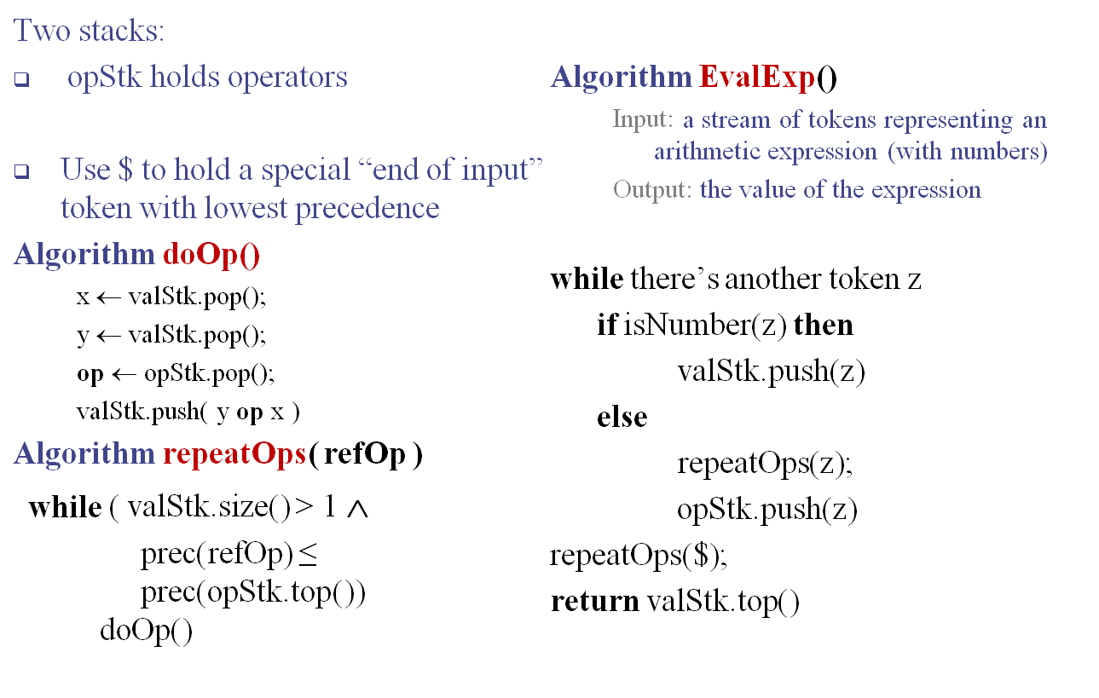
Algorithm for
Evaluating Expressions
Stacks

Slide 24
Algorithm on an
Example Expression
Slide by Matt Stallmann included with permission.
Operator ≤ has lower precedence than +/–
14 ≤ 4 – 3 * 2 + 7
4
–
14
≤
3
*
$
$
4
–
7
$
14
≤
F
+
-2
+
5
+
14
≤
14
≤
2
2
3
*
3
*
6
4
–
4
–
4
–
-2
+
14
≤
14
≤
14
≤
14
≤
Stacks

Slide 25
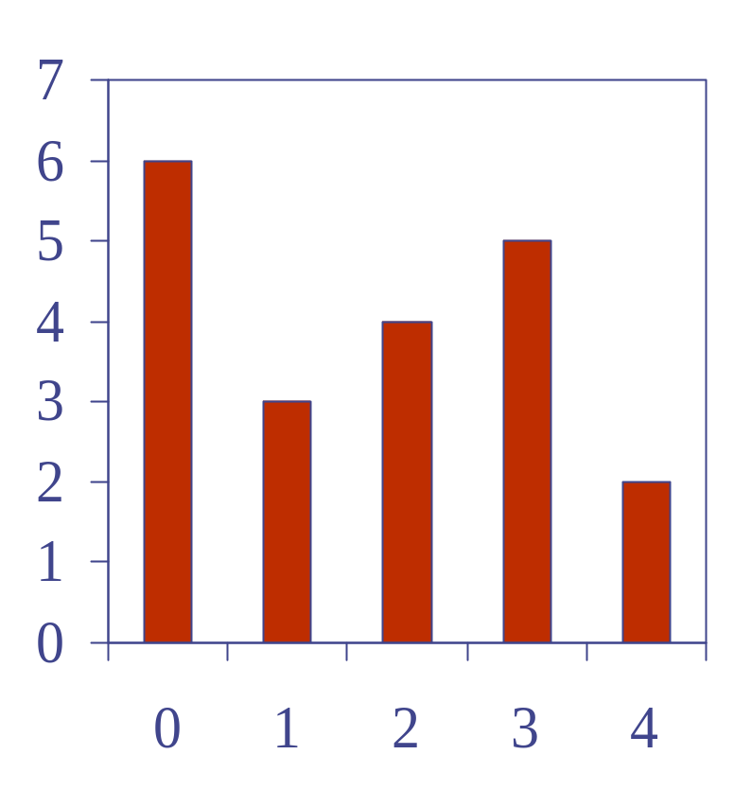
Computing Spans (not in book)
Using a stack as an auxiliary data structure in an algorithm
Given an an array X, the span S[i] of X[i] is the maximum number of consecutive elements X[j] immediately preceding X[i] and such that X[j] ≤ X[i]
Spans have applications to financial analysis
  E.g., stock at 52-week high
X
6 | 3 | 4 | 5 | 2
1 | 1 | 2 | 3 | 1
S
Stacks

Slide 26
Quadratic Algorithm
Algorithm spans1(X, n)
Input array X of n integers
Output array S of spans of X #
S ← new array of n integers n
for i ← 0 to n − 1 do n
s ← 1 n
while s ≤ i ∧ X[i − s] ≤ X[i] 1 + 2 + …+ (n − 1)
s ← s + 1 1 + 2 + …+ (n − 1)
S[i] ← s n
return S 1
Algorithm spans1 runs in O(n²) time
Stacks

Slide 27
Computing Spans with a Stack
We keep in a stack the indices of the elements visible when “looking back”
We scan the array from left to right
  Let i be the current index
  We push the index as long as the one prior to it has a smaller value
  We pop all elements otherwise
Each index of the array
  Is pushed into the stack exactly once
  Is popped from the stack at most once
Stack height for the pushed index represents the needed value
Stacks

Slide 28
Computing Spans with a Stack
X
index
0 | 1 | 2 | 3 | 4 | 5 | 6 | 7 | 8
6 | 3 | 4 | 5 | 2 | 7 | 3 | 8 | 2
Example
Value
0
1
2
1
3
2
1
2
1
1
4
5
4
4
6
7
6
6
8
S
1 | 1 | 2 | 3 | 1 | 2 | 1 | 2 | 1
Stacks

Slide 29
Linear Algorithm
We iterate on the array n times
Each index is then pushed and popped at most once, which totals to n + n
Consequently algorithm spans2 has a complexity of O(n)
Stacks

Slide 30
Growable Array-based Stack
In an push() operation, if the stack is full (no more empty locations in the array), we can throw an exception and abort/reject the operation.
Alternatively, we can extend the array; which is actually replacing it with a larger one.
How large should the new array be?
  Incremental strategy: increase the size by a constant c
  Doubling strategy: double the size
Algorithm add(o)
if t = S.length − 1 then
A ← new array of
size …
for i ← 0 to t do
A[i] ← S[i]
S ← A
t ← t + 1
S[t] ← o
Stacks

Slide 31
Comparison of the Strategies
We compare the incremental strategy and the doubling strategy by analyzing the total time T(n) needed to perform a series of n push() operations.
We assume that we start with an empty stack represented by an array of size 1.
We refer to the average time taken by a push() operations over the series of operations, i.e., T(n)/n, the amortized time of a push() operation.
Stacks

Slide 32
Incremental Strategy Analysis
We need to find the amortized time to perform one push() operation.
  That is the total time to perform n push() operations / n.
In general, we need to replace the array k = n/c times for all n push() to take place.
  For instance if n = 100, and c = 4, we need to go through 25 (100/4) replacements for all push() operations to take place.
  Notice also that each replacement is larger than the previous one by c.
Stacks

Slide 33
Incremental Strategy Analysis
Consequently, the total time T(n) of a series of n push() operations is proportional to:
n + c + 2c + 3c + 4c + … + kc =
n + c(1 + 2 + 3 + … + k) =
n + ck(k + 1)/2
Since c is a constant, T(n) is O(n + k²), i.e., O(n²). That is
T(n) is the complexity to perform n push() operations. Hence, the amortized time of one single push() operation is O(n).
Stacks

Slide 34
Doubling Strategy Analysis
We replace the array k = log₂ n times.
  For instance, to perform 1000 push() operations, we need to expand the array 10 times (1 -> 2 -> 4 -> 8 -> 16 -> 32 -> 64 -> 128 -> 256 -> 512 -> 1024).
The total time T(n) of a series of n add operations is proportional to
n + 1 + 2 + 4 + 8 + …+ 2^{k} =
n + 2^{k + 1} − 1 = n + 2n -1 =
3n − 1.
geometric series
2
4
1
1
8
Stacks

Slide 35
Doubling Strategy Analysis
Consequently, T(n) (which is needed to perform n push() operations) is O(n).
Hence, the amortized time of a single push() operation is O(1).
geometric series
2
4
1
1
8
Stacks

